Slide 1
Factors affecting Equilibrium 2
Pressure and temperature
ATAR Chemistry Unit 3 2021

Slide 2
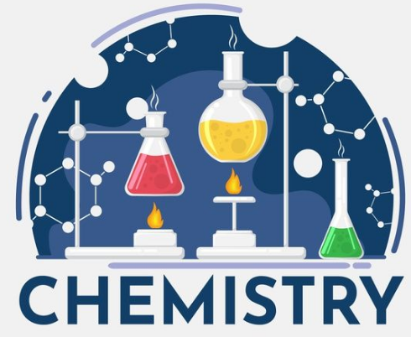
Outline
Factors affecting equilibrium continued:
Pressure
Temperature
Changes with no effect – e.g. adding a catalyst

Slide 3
Pressure change
We may encounter three scenarios:
We selectively add or remove just one gaseous substance – this changes the partial pressure of that substance which is equivalent to changing the concentration of that substances.
Changing the total pressure by changing the volume of the system.
Increasing the total pressure by adding a non-reacting, spectator gas.

Slide 4
Partial Pressure change
Adding or removing one gaseous substances – equivalent to changing the concentration of that species
Please refer to discussion of changing concentration
In this scenario, you will see an instantaneous change in concentration of one species and then a gradual change in the others as the equilibrium adjusts to the imposed change
The example on Example 3 p 17 Essential Chemistry is a great example of this scenario.

Slide 5
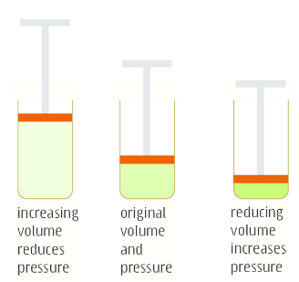
Total Pressure change
Changing total pressure by changing the volume of the system
Imposed changed: volume which changes the total pressure of the system
Le Chat prediction: Equilibrium will try to minimize the change by adjusting the total moles of gas present I the system

Slide 6
Total Pressure change
Increasing the pressure (reducing the volume):
Favour the side of the equilibrium with fewer moles of gas
Fewer moles of gas means less collisions with sides of container and therefore a lower pressure, partially counteracting the imposed changed
Decreasing the pressure (increasing the volume):
Favour the side of the equilibrium with more moles of gas
More moles of gas means more collisions with the sides of the container and therefore a higher pressure, partially counteracting the imposed change

Slide 7
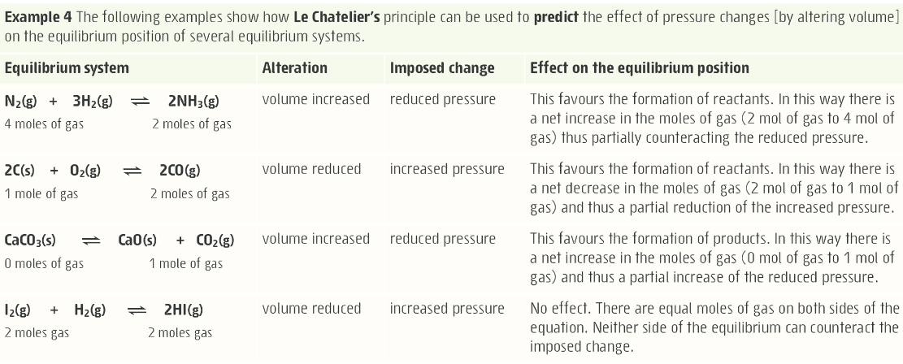
Total Pressure change

Slide 8
Total Pressure change
forward
reverse
concentration
N_{2(g)}
rate
NH_{3(g)}
H_{2(g)}
time
time
Increase Total pressure

Slide 9
Important notes on pressure
If both sides of the equilibrium have the same number of moles of gas, changing the total pressure (changing the volume) will have no effect on the equilibrium position
Add in an inert gas or non-reacting gas has no effect on the equilibrium position

Slide 10
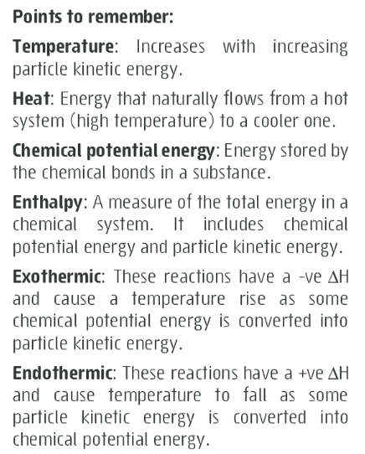
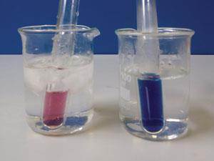
Temperature
Changing temperature of the system
Imposed changed: temperature of the system
Le Chat prediction: Equilibrium will try to minimize the change by adjusting the temperature of the system
Co(H₂O)₆²⁺ _{(aq)} + 4 Cl⁻ _{(aq)} ⇄ CoCl₄²⁻ _{(aq)} + 6 H₂O _{(l)}
for which ΔH > 0.

Slide 11
Temperature
Increasing the temperature:
Favours the endothermic side of the equilibrium
Converts some of the added heat in to chemical potential energy, this causes the temperature of the system to drop which partially counteracts the change
Decreasing the temperature:
Favour the exothermic side of the equilibrium
Converts some chemical potential energy to heat, this causes the temperature of the system to rise which partially counteracts the change

Slide 12
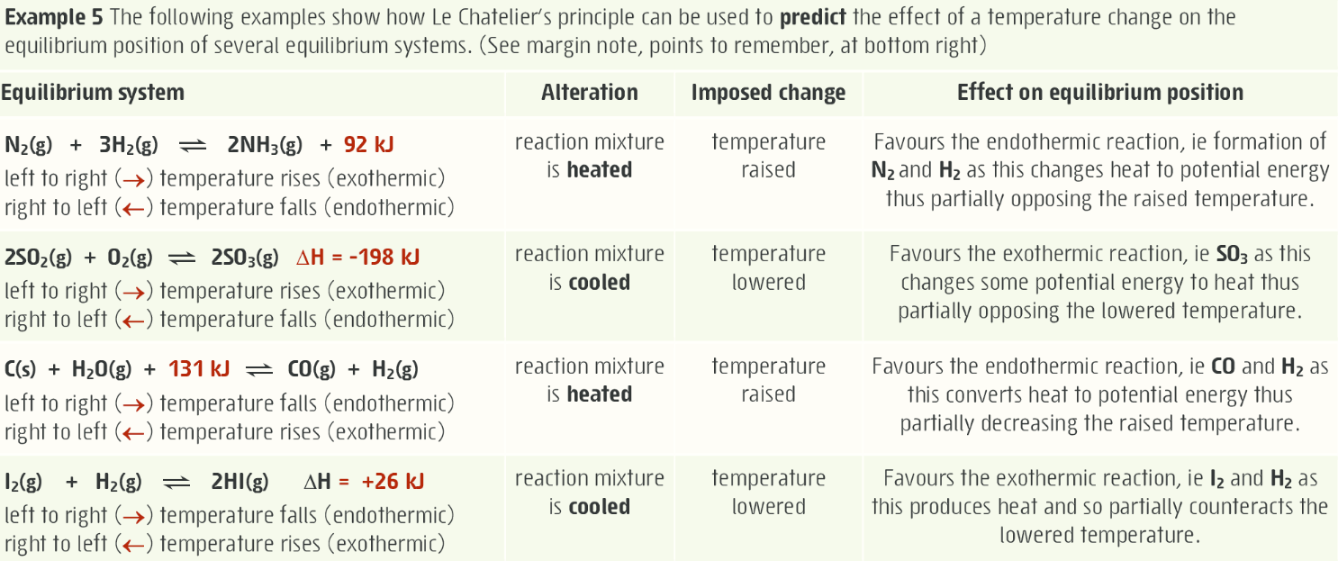
Temperature

Slide 13
Temperature
Changes in temperature effect endothermic and exothermic processes differently
Endothermic reaction rates are more sensitive to changes
Increase temperature – increases endo rate more than exo rate
Decrease temperature – decreases endo rate more than exo rate
This results in the proportion of products to reactant to change, which changes the Kc value for the equilibrium.

Slide 14
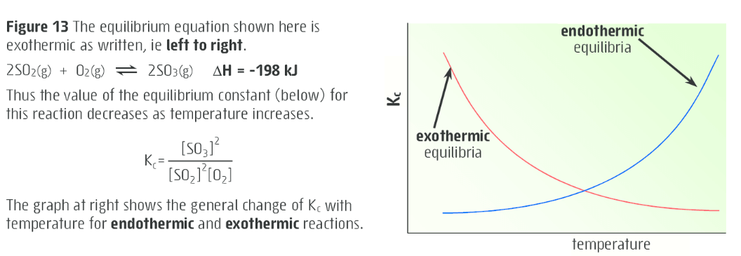
Temperature
Endothermic reaction: Kc increases as temperature increases
Exothermic reaction: Kc decreases as temperature increases

Slide 15
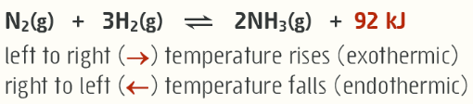
Temperature change
forward
reverse
concentration
N_{2(g)}
rate
NH_{3(g)}
H_{2(g)}
time
time
Increase Temperature

Slide 16
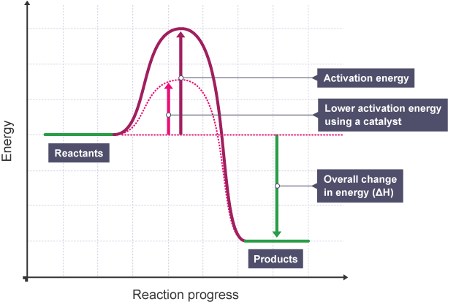
Other alterations
Catalyst – no effect on equilibrium position, but does speed up how quickly we reach equilibrium as it increases the forward and reverse reaction rates equally
Changing amount of solids or liquids present – does not alter equilibrium position as they have fixed concentration (not a factor in determining Kc)

Slide 17
On going work
Essential chemistry 2.5 to 2.11, problem set 2 up to Q 19
STAWA Set 5 and 6
Pre-lab for Experiment 4: Le Chat principle for aqueous solutions

